Slide 1


Nirwana Team
HORIZONU
UNIFORM
Business Web Solution

Slide 2


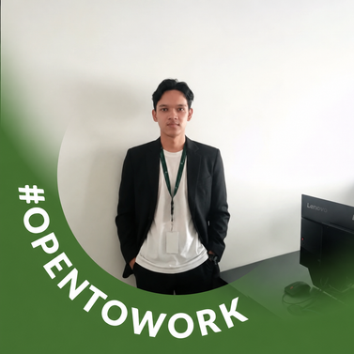




Our Team
Fhazar Raffiful
Aqyla
Ferry Noer Hendriawan
Hildan Anugrah Tamadi Putra
Project Manager
Frontend Developer
Backend Developer
Fadel Rahmadhan
Daffa Nazriel Zaidan
Acep Ugan Saputra
Quality Assurance
UI/UX Designer
System Analyst

Slide 3



Identity & Object of Observation
Business/Organization :
Department of Finance at Horizon University Indonesia, focusing on uniform inventory management and student uniform distribution.
Target Audience :
FINANCE STAFF
HORIZONU STUDENT
How is the business curently managed?
Currently, the Finance Team uses Excel to record and manage student uniform inventory and distribution. Distribution schedules are announced via email, while stock records and pickup statuses are still managed manually.

Slide 4

Observation Result
Problem 1
Uniform distribution announcements are sent manually to each student’s email and take a long time.
Problem 2
Increasing amounts of data cause Excel to lag, become unresponsive, or crash.
Problem 3
Information about the uniforms received is manually sent to each student's email.
Problem 4
QR codes also generated manually to verify student identities, making the process time-consuming.

Slide 5
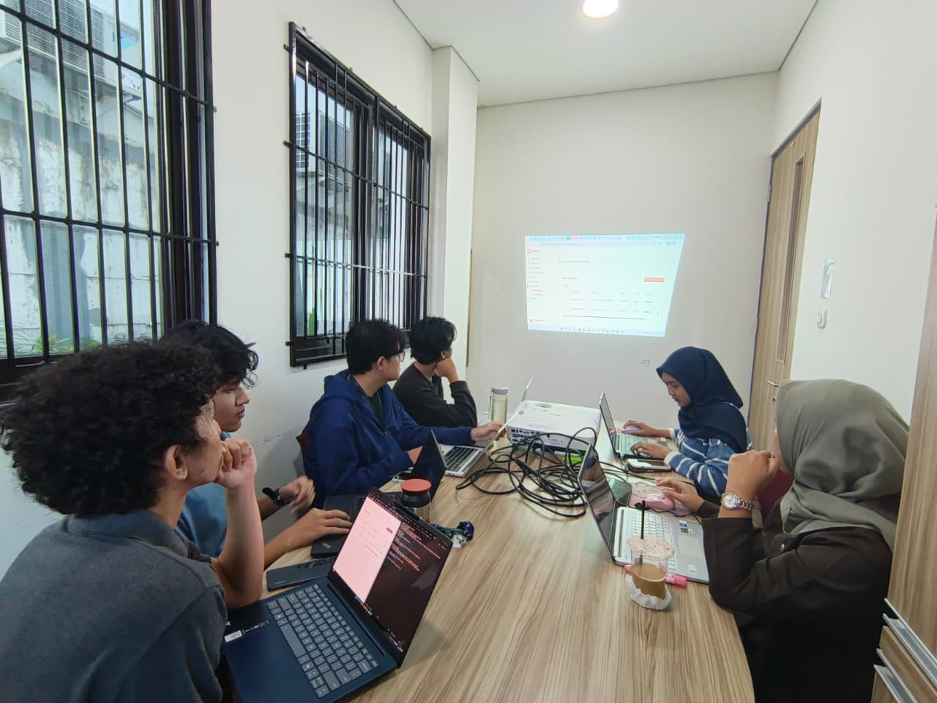
Problem Statement
“The Finance Staff faces difficulties managing uniform distribution because announcements, inventory records, information delivery, and pickup validation are still handled manually, resulting in time-consuming processes and potential operational issues.”
What does the Finance Staff need to make uniform distribution more efficient and manageable?

Slide 6

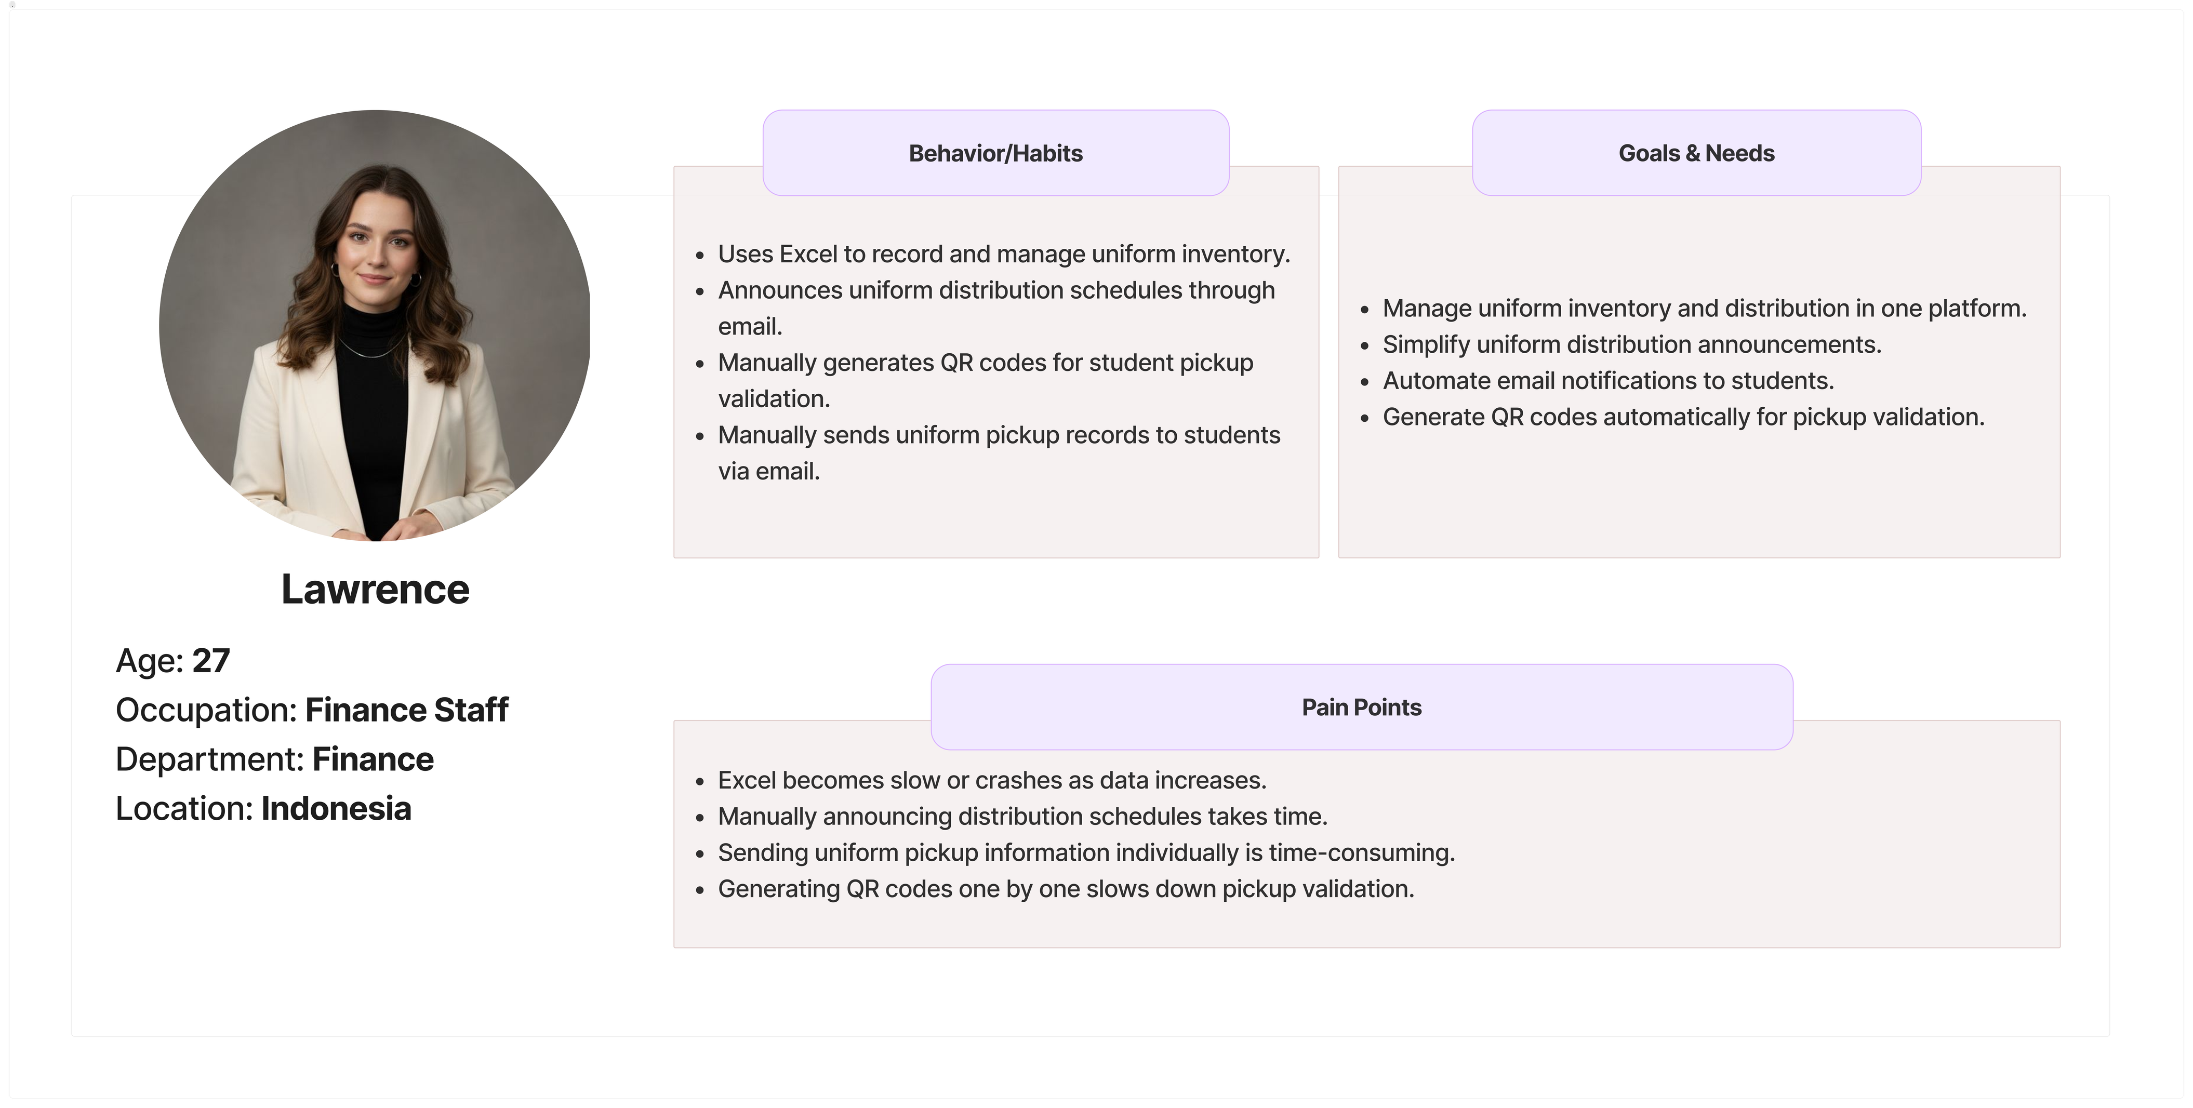
User Persona

Slide 7

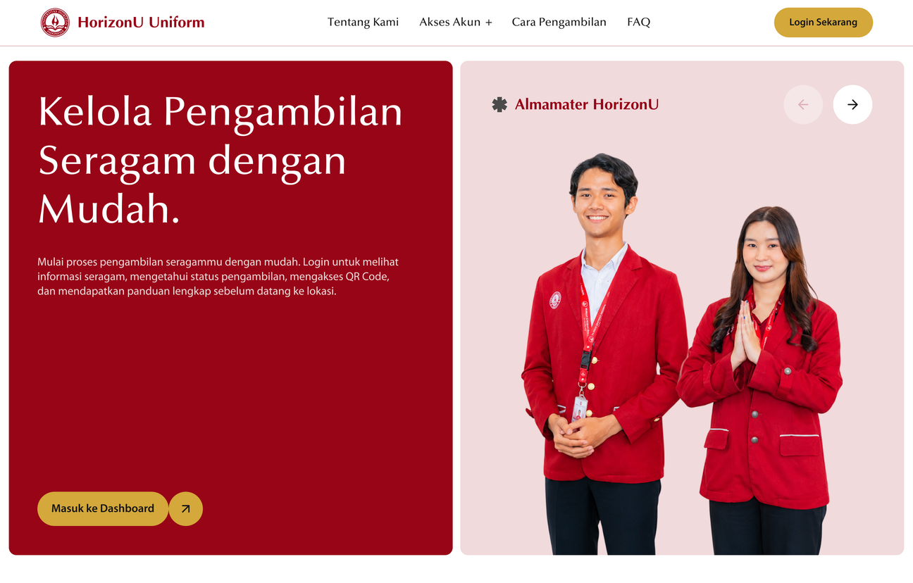

Web Solution Ideas
What is HorizonU Uniform?
HorizonU Uniform is a centralized platform designed to help the Finance Staff manage the entire uniform supply chain and distribution process. For students, the website provides easy access to uniform distribution information and a more convenient pickup process.
How the Website Helps?
  Integrates uniform business process into one platform.
  Simplifies uniform distribution announcements and pickup notifications.
  Supports growing student data volumes to minimize performance issues encountered with Excel.
  Automatically generates QR codes based on student identities.
HorizonU Uniform Web

Slide 8



Stock Analytics Dashboard
01
Monitor uniform stock levels and identify minimum, low, and high stock conditions to support better inventory decisions.
Data & Entitlement Management
4 Key Features of HorizonU Uniform
02
Manage student and uniform data through master data, data imports & defining each student's uniform entitlements.
03
Event & Announcement Management
(Finance Dashboard)
Create uniform distribution and size-change events, while simplifying announcements to students.
04
QR Code & Pickup Validation
Automatically generate QR codes based on student identities to verify identities and uniform entitlements during pickup through scanning.

Slide 9

Prototype
Progress

Slide 10

Questions or Feedback?

Slide 11

Thank you

